Slide 1
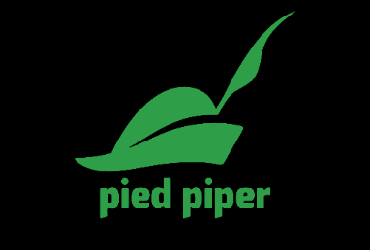
Day 1 & 2
Cloud Native, Agile, DevOps, Container & Kubernetes
Disclaimer:
All product and company names are trademarks™ or registered® trademarks of their respective holders. Use of them does not imply any affiliation with or endorsement by them

Slide 2
Piper “Virtual”- Schedule – 2 Days – 3 Hours Only Agenda- With Modules
 | Day 1 |  | Day 2
13:30 – 14:25 | Cloud Native Intro Piper Program - Astri Module 1 - Cloud Native Apps - Andri Module 2 - Agile Concepts - Astri Module 3 - DevOps Concepts - Astri Module 4 – PaaS - Andri | 8:30 – 9:30 | Lab 1 – Github - Astri Lab 3 – Clone the Github repo - Astri Lab 01 – Docker – Yusra
14:25 – 14:35 | Break (10 minutes) | 9:30 – 9:40 | Break (10 minutes)
14:35 – 16.30 | Containers Module 01 - Microservices & Containers - Andri Module 02 – Docker - Yusra Module 03 – Kubernetes –Yusra Module 04 – Persistent Storage - Yusra Module 05 – CaaS - Andri | 9:40 – 11.30 | Lab 02 – Kubernetes - Yusra Lab 03 - Containerising an App - Yusra Lab 04 –Persistent Storage (CSI) - Yusra Lab 05 –TKG - Andri

Slide 3
Introduction
Piper Bootcamp
Astri

Slide 4
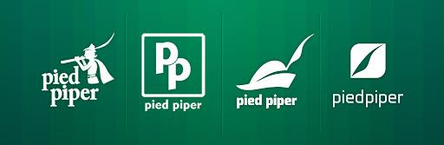
Disclaimer:
All product and company names are trademarks™ or registered® trademarks of their respective holders. Use of them does not imply any affiliation with or endorsement by them

Slide 5

Piper Mission
Support customers on their digital transformation journeys focusing on the cultural change associated with Agile/Lean, DevOps and modern cloud native application architectures

Slide 6
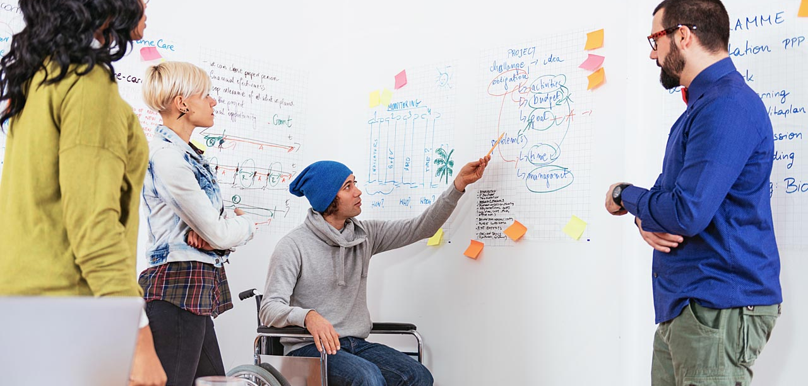
Piper Customer Audience
Organization Profile:
In-house software development (20+)
In house IT operations teams
Enterprise Architects and Engineering teams interested in modernizing applications with containers
Focus areas
Modern infrastructure & platforms
Cloud native application technologies
Attendees:
Architects
Administrators
Operators

Slide 7
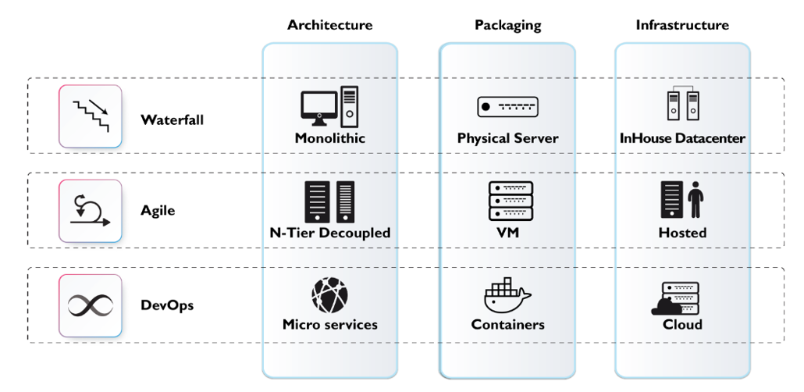

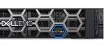

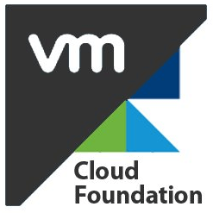

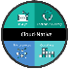
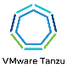
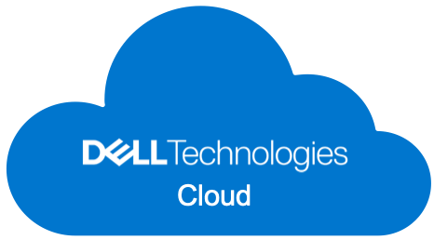
How does Dell Technologies help?
Infrastructure changes with Agile and DevOps

Slide 8
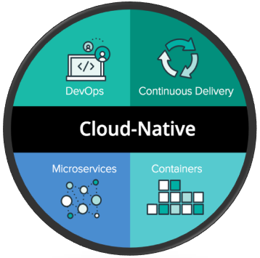
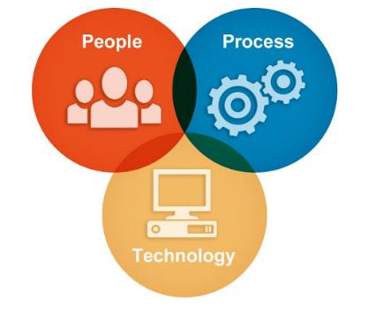
What You Will Learn

Slide 9
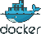
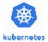
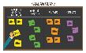
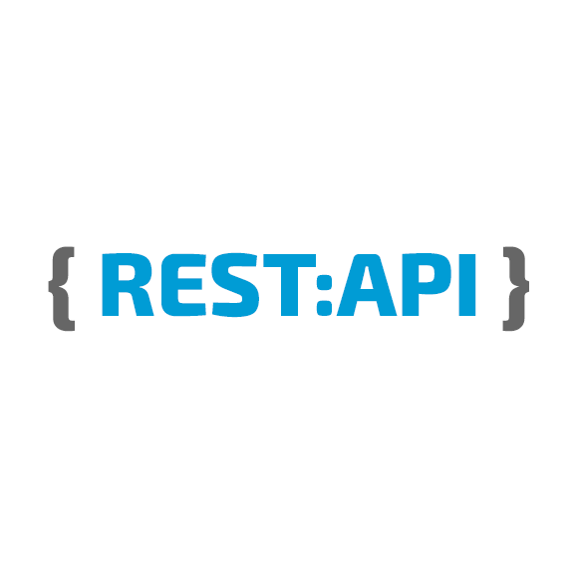



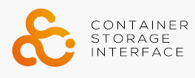
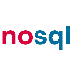

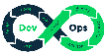
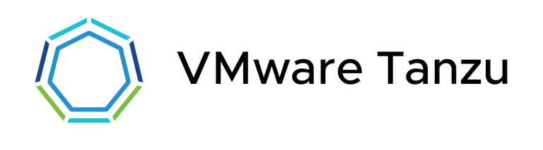
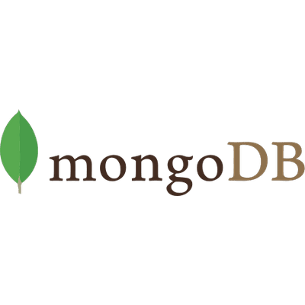

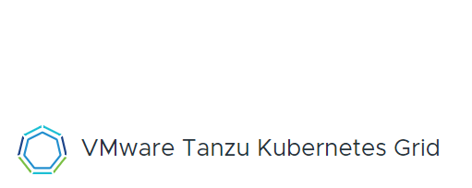

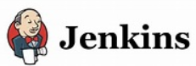

Piper Cloud Native Core Workshop
Cloud Native App Dev
Containers & PaaS
Infrastructure Automation
Object Storage
Tanzu Architecture 4 VxRail
Application Service

Slide 10
Cloud Native Apps
Piper Bootcamp: Module 1
Andri

Slide 11

First some context
Technology
Process
People
Application
Business Service

Slide 12

How Successful are Software Projects?
18% of software projects are considered "failed“
43% "challenged"
39% actually succeeding
-- 2012 study by The Standish Group.
Unhappy Customers
Unhappy Developers

Slide 13

What is required?
Need to scale quickly up and down
Need to patch without disruption
Need to withstand infrastructure failures
Need to be moved easily between clouds
Need to be cheaper to deploy and run
a.k.a CNA’s (Cloud Native Applications)

Slide 14
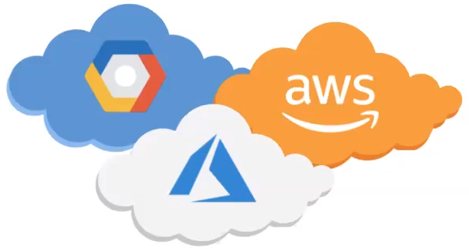

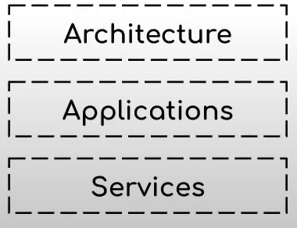
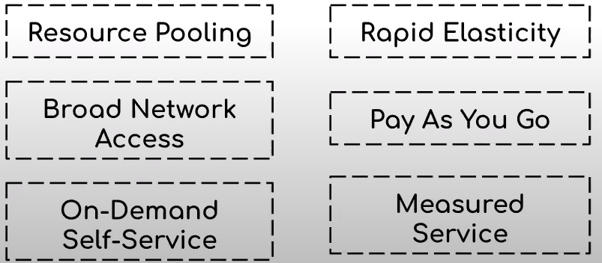
Cloud Native vs. Cloud Computing
Are they the Same?

Slide 15
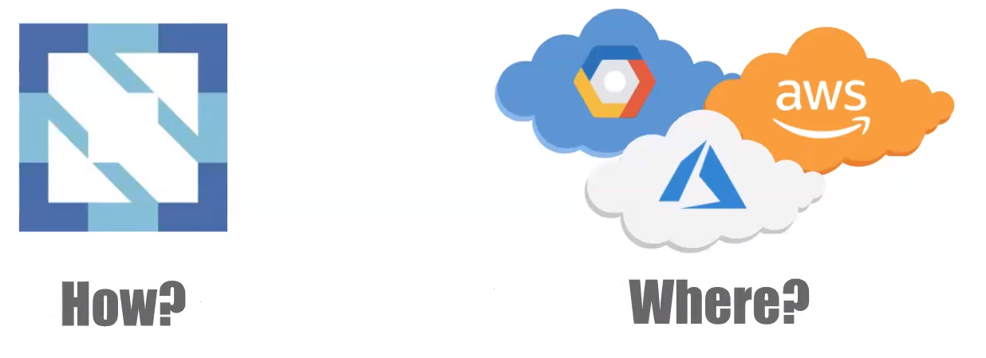
Cloud Native vs. Cloud Computing
Are they same?
Cloud Native development is an approach to building and running applications that fully exploits the advantages of the cloud computing delivery models

Slide 16
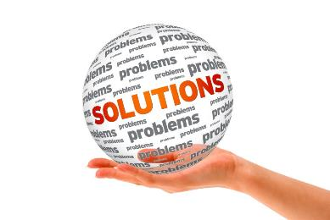
What makes a CNA different?
Operate at much greater scale on much more data
Use a more varied backend options, e.g. NoSQL
Open Source components at all Levels
Provide reliability at software level
Like to treat infrastructure as code

Slide 17
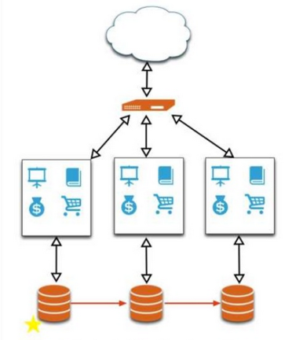
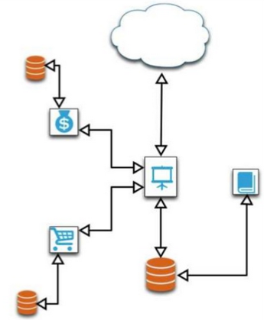
What makes a CNA different?
Tend to be built on Microservices
Communicate through standardized message channels

Slide 18




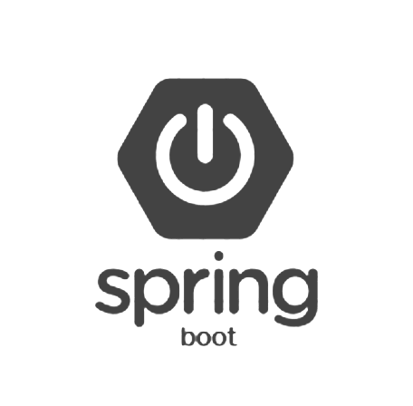
CNAs are Limitless
More choice
Greater velocity
Better resiliency
Warehouse
Inventory
Authentication
Payments
Printing
Order
Email
Shopping
Factory
Packing
Notification
Delivery
VMware Cloud on Dell EMC
VMC on AWS
AWS
Azure

Slide 19
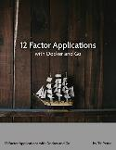
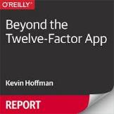
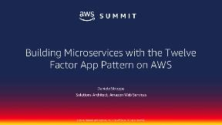
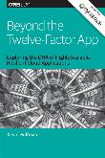

How to build CNAs- The Twelve Factor App
A methodology for building software-as-a-service applications
Programming language agnostic
Good design principles for successful microservices architecture
It’s all about making application scalable, resilient, maintainable and secure
https://12factor.net/
Notes:
Ultimately, It’s all about making application scalable, resilient, maintainable and secure

Slide 20
How do they achieve it? 12-Factors
Codebase: Single Codebase with many branches tracked In revision control, many deploys
Dependencies: Explicitly declare and isolate dependencies
Config: Store config in the environment: credentials, resource
Backing Services: Treat backing services as attached resources
Build, Release, Run: Strictly separate build and run stages. The heavy lifting happens at Build
Processes: Execute the app as one or more Stateless processes
Notes:
http://www.clearlytech.com/2014/01/04/12-factor-apps-plain-english/
https://www.ctl.io/blog/post/appfog-and-twelve-factor-apps-explained/
https://thenewstack.io/12-factor-app-streamlines-application-development/

Slide 21
How do they achieve it? 12-Factors
Port Binding: Export services via port binding. Use a URL
Concurrency: Use lots of (scaled-out) little processes (“microservices”) to increase concurrency
Disposability: Maximize robustness with fast startup and graceful shutdown
Dev/Prod Parity: Keep dev/staging/prod as similar as possible. Intuitive but important in a world of very fast release cycles
Logs: Treat logs as event streams. Consolidate and use them
Admin Processes: Run admin/management tasks off a box in the production environment that is identical to production
Notes:
http://www.clearlytech.com/2014/01/04/12-factor-apps-plain-english/
https://www.ctl.io/blog/post/appfog-and-twelve-factor-apps-explained/
https://thenewstack.io/12-factor-app-streamlines-application-development/

Slide 22
Agile
Piper Bootcamp: Module 2
Astri

Slide 23
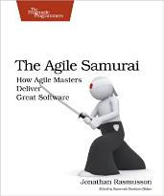
Agile
You can't gather all the requirements up front
The requirements you do gather will change
There is always more to do than time and money will allow
-- The Agile Samurai, J. Rasmusson

Slide 24
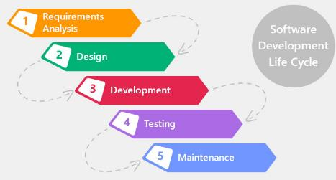
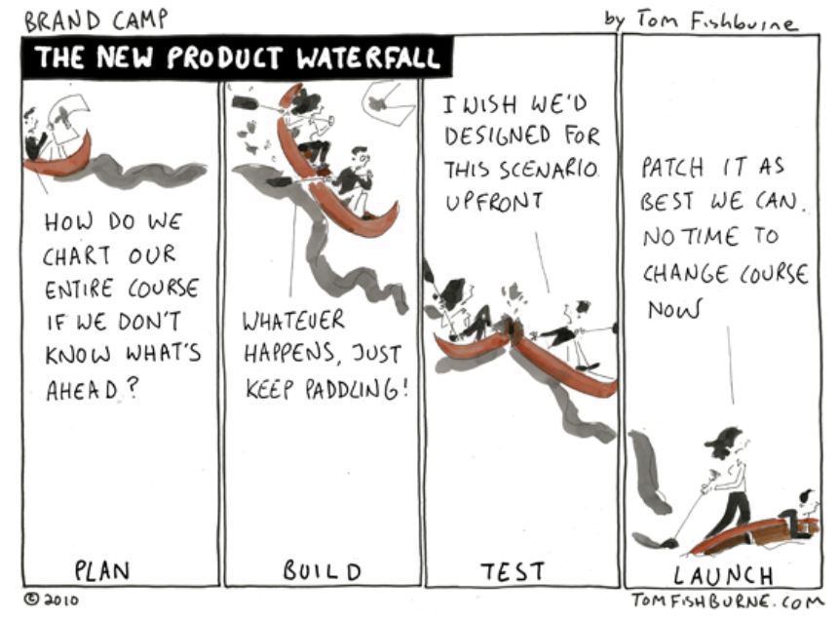
Traditional SDLC
Traditional Waterfall approach & its challenges

Slide 25


Agile Manifesto
Individuals and Interactions
Processes and Tools
Working Software
Comprehensive Documentation
Customer Collaboration
Contract Negotiation
Responding to Change
Following a Plan

Slide 26
Agile Concepts – Iterative Development
Iterative and Incremental development
Focus on MVP (Minimum Viable Product)
Welcome changing requirements, even late in development
Notes:
12 Principles of Agile
https://www.linkedin.com/pulse/12-agile-manifesto-principles-simply-explained-jacob-aliet-ondiek
https://www.scrumalliance.org/community/articles/2013/november/the-agile-manifesto-principles-what-do-they-mean

Slide 27
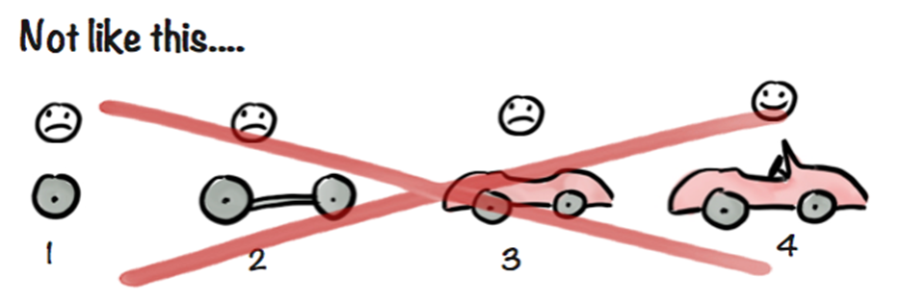
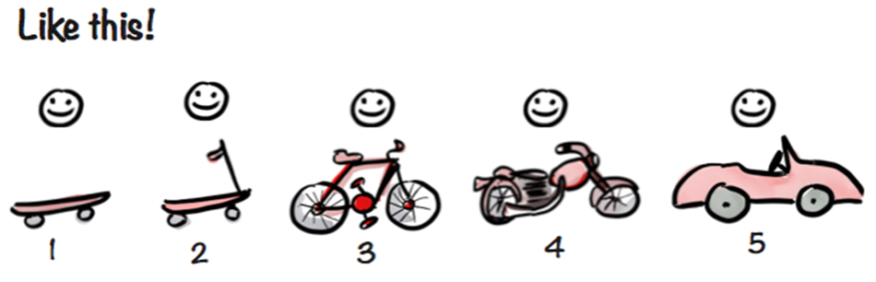
Minimum Viable Product- an Example of Agile Approach

Slide 28
Agile Concepts - People
Self organizing teams
Business and developers work together = SCRUM
Product Owner: Owns the backlog, prioritizes
Scrum Master: Just a facilitator, with no management authority. Removes roadblocks
Whole team is responsible for Planning and Scheduling
Development Team
Notes:
12 Principles of Agile
https://www.linkedin.com/pulse/12-agile-manifesto-principles-simply-explained-jacob-aliet-ondiek
https://www.scrumalliance.org/community/articles/2013/november/the-agile-manifesto-principles-what-do-they-mean
作者：陈甫鸼 链接：https://www.zhihu.com/question/19638322/answer/17899852 来源：知乎 著作权归作者所有。商业转载请联系作者获得授权，非商业转载请注明出处。 Scrum 的目的在于两点： 适应变化。Scrum 的一个基本假设，就是外部需求模糊而难以理解。Scrum 对此的理念是：让客户直接看到半成品，他们才知道自己要什么。很多 Scrum 的原则都是围绕如何解决这个问题的：比如每个 Sprint 结束时由 Product Owner 为客户进行展示，又比如任务细化一般不超过一个 Sprint。理解了这一点，才会理解为什么 Scrum 似乎总在变化，因为需求总在变化。
快速迭代。Scrum 的另一个基本假设，是团队生存在一个快速变化且充满竞争的世界。如果自己一年半才能发布一个新版本，而竞争对手半年就能发布，那么几年之内，我们就会被对手甩得远远的。Scrum 对此的理念是：发布即 Milestone（里程碑），宁可每次发布二十个功能发布五次，也不要在内部搞五个 Milestone 然后一口气发布一百个功能。理解了这一点，才会理解为什么 Scrum 会认为发布时砍功能是一种正常情况而非一种失败。
要实施 Scrum，整个团队至少必须取得共识，即以上两点是不能商量的。流程必须为目的服务。如果队伍相信增加前期沟通才是让需求清晰起来的最好方法，或者相信发布的功能必须是大批量一次性，那么请使用瀑布开发模式。

Slide 29
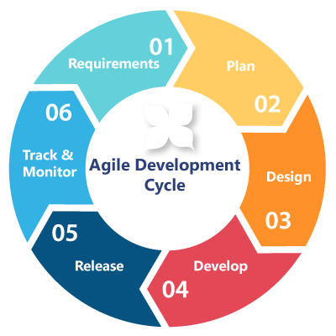
Agile Concepts – Process I
Continuous delivery of ‘working’ software
In short cycles called Sprints
1-4 weeks duration, typically 2
Start with ‘sprint planning session’
Daily Stand-up (done, issues, next)
‘Walk the board’
End with ‘sprint retrospect’ and demo
Notes:
12 Principles of Agile
https://www.linkedin.com/pulse/12-agile-manifesto-principles-simply-explained-jacob-aliet-ondiek
https://www.scrumalliance.org/community/articles/2013/november/the-agile-manifesto-principles-what-do-they-mean

Slide 30
Agile Concepts – Process II
User stories/Epics
As a {x}, I want {y} in order to {z}.
Product Backlog
Agile Board / Scrum Board
Release Backlog → Workflow → ‘Done pile’
Video: “Scrum in under 10 minutes”
Scrum vs ‘Kanban’ → service and support
Notes:
Stories, also called “user stories,” are short requirements or requests written from the perspective of an end user.
Epics are large bodies of work that can be broken down into a number of smaller tasks (called stories).
12 Principles of Agile
https://www.linkedin.com/pulse/12-agile-manifesto-principles-simply-explained-jacob-aliet-ondiek
https://www.scrumalliance.org/community/articles/2013/november/the-agile-manifesto-principles-what-do-they-mean

Slide 31
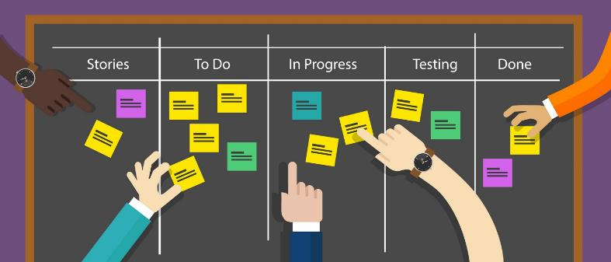
Scrum Board

Slide 32
DevOps
Piper Bootcamp: Module 3
Astri

Slide 33
What about DevOps?
First two famous quotes:
I didn’t change anything!
-- every developer
, ever
Well the environment didn't change!
-- every ops person, ever.

Slide 34
What is DevOps?
A Culture that emphasizes
Collaboration/communication between Dev/QA and IT Ops
Automating the process of software delivery and infrastructure changes

Slide 35
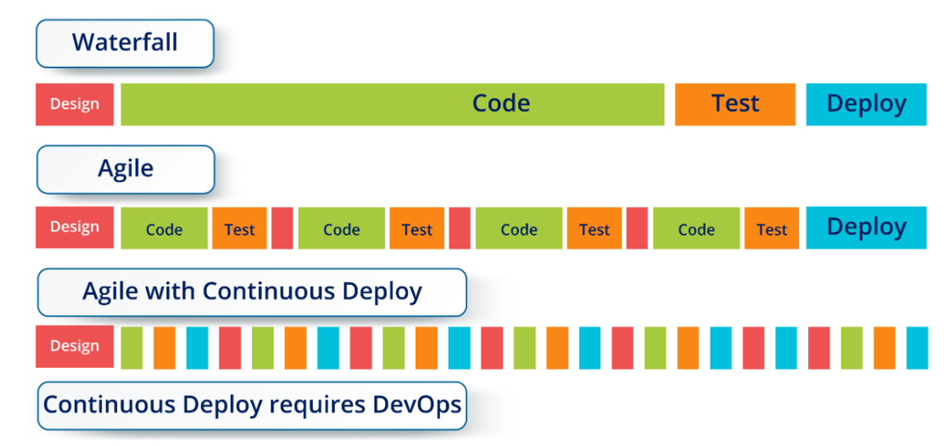
Waterfall vs. Agile vs. DevOps
Notes:
How is Agile diff from Devops
Coded once and depoyed once.
Iterative and incremental design, code, test

Slide 36
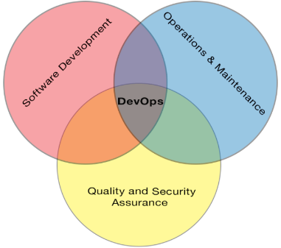
Advantages of DevOps
Better documentation
Better logging
Faster issue resolution
Smoother deployments
Better code + Better support = Successful Projects

Slide 37
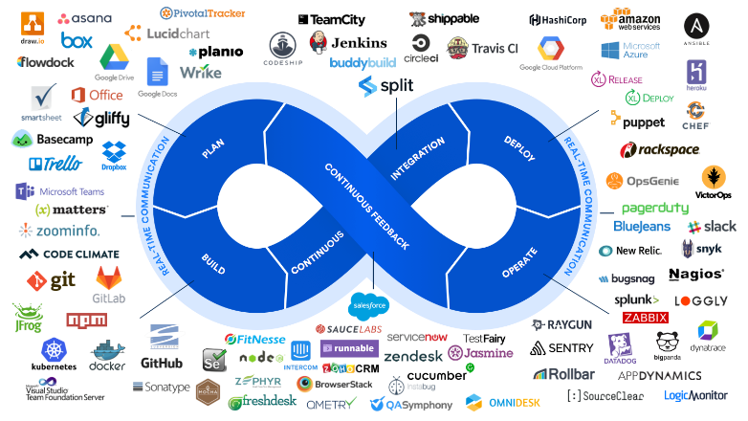
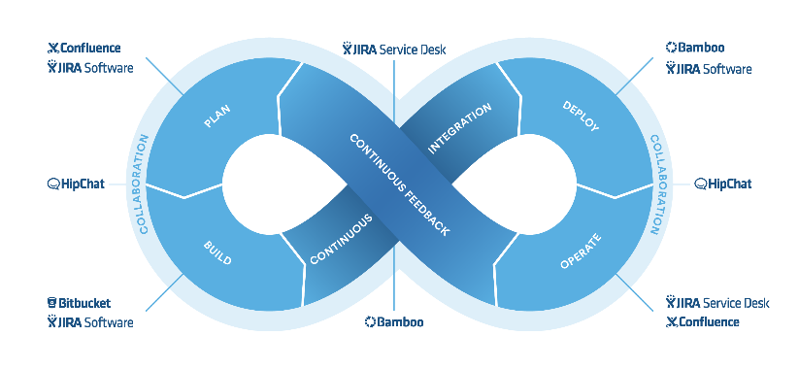
DevOps Toolchain

Slide 38



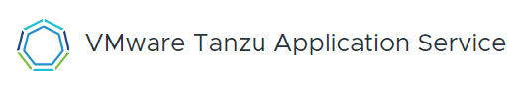
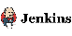
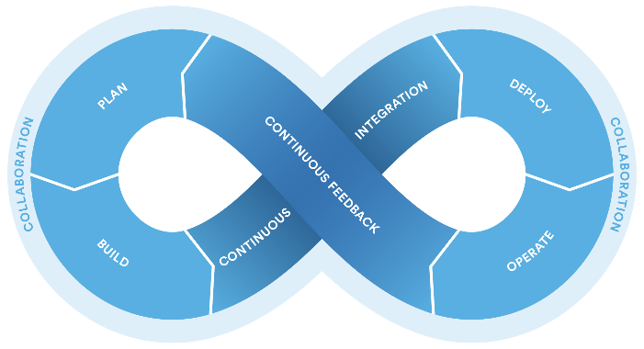


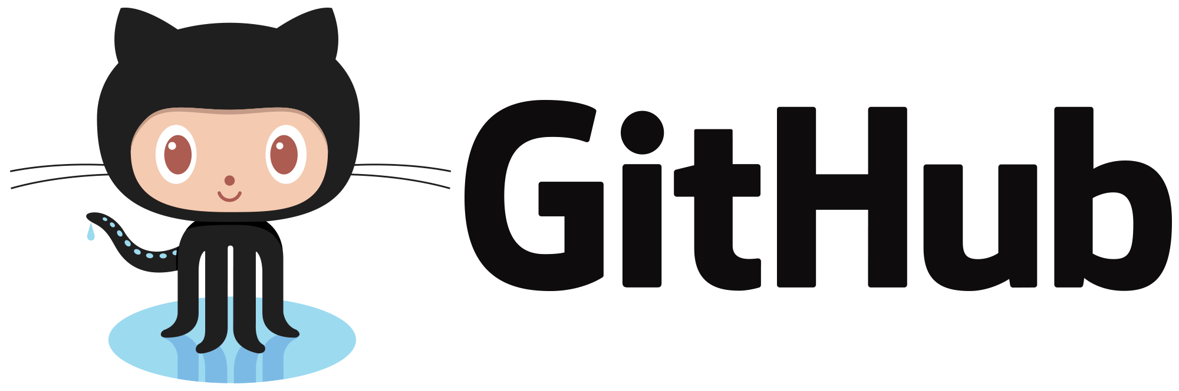
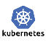






Piper Toolchain
Email

Slide 39
The Five Levels of DevOps
Values:
Culture, Automation, Measurement, Sharing (CAMS)
Principles:
Systems Thinking, Amplifying Feedback Loops, Continuous Experimentation and Learning (The Three Ways)
Methods:
People over process over tools, Continuous Delivery, Lean Management, Change Control, Infrastructure as Code
Practices:
Incident Command System, Developers On-Call, Public Status Pages, Blameless Post-mortems, Embedded Teams, The Cloud, Andon Cords, Dependency Injection, Blue/Green Deployment, Chaos Monkey
Tools:
Tool chains
Programmable, Verifiable, Well Behaved

Slide 40



Dev & Ops vs. DevOps
Agile & Microservices is Half the battle Won
People & Process Transformation
DevOps Adoption Journey
Cultural Transformation
Technology Transformation
Automate Everything
Adoption of Tools

Slide 41

RECAP
Technology
Process
People
Agile
DevOps
Hey, hold on!
What about this?

Slide 42
Platform as a Service
Piper Bootcamp: Module 4
Andri

Slide 43
Why is PaaS important?
Technology
Process
People
Agile
DevOps
Let’s talk about this

Slide 44

What about Technology?
PROBLEM
Application provides resilience
CONSEQUENCE
Backend is less relevant
Requirements satisfied with just compute
With some software on top → THE PLATFORM

Slide 45




Two Types Of Cloud Native Platforms
Unstructured
Structured
Ultra-flexible
Max opportunity for optimization
For companies where platform = core competency
Common in SaaS startups where there are relatively few, bespoke apps
Opinionated
Fastest & reliable outcome
Largest community of talent
Common in enterprise where there are many apps

Slide 46

VMware Tanzu Application Service
v2.9
Beta
v0.1

Slide 47

Cloud Foundry Architecture overview
UAA = User Account and Authentication
DEA = Droplet Execution Engine
It was rewritten in GO and renamed Diego
Garden is CF’s container technology
It was originally called Warden in GO
And it was renamed “Garden”
BOSH deploys all CF components:
Who manages what?
- Diego → app lifecycle
- BOSH → CF components lifecycle
Notes:
https://docs.pivotal.io/pivotalcf/1-10/concepts/architecture/index.html
https://cloudacademy.com/blog/cloud-foundry-components/
https://www.cloudfoundry.org/blog/cloud-foundry-containers-difference-warden-docker-garden/
Buildpacks are the scripts through which Cloud Foundry identifies the required runtime or framework for the application. Buildpacks are responsible for identifying an application’s related dependencies based on user-provided artefacts. They will then ensure everything is properly downloaded and configured.
Droplet. Once an application is pushed to Cloud Foundry and deployed using a buildpack, the result is a droplet. A droplet, therefore, is nothing but an abstraction on top of the application that contains information like metadata. Those droplets are stored in blob storage for further deployment processes.
Garden. Once the droplet is ready, it will need hosting in a suitable environment. In Cloud Foundry, this is called a Garden container. Wardens isolate ephemeral and resource-controlled environments.
Diego Cell. Application instances, application tasks, and staging tasks all run as Garden containers on the Diego Cell VMs.
Diego selects the appropriate buildpack and use that to both stage your application, and ensure complete life cycle management of its application instance.
nsync, BBS, and Cell Reps. To keep applications available, cloud deployments must constantly monitor their states and reconcile them with their expected states, starting and stopping processes as required. In pre-Diego architecture, the Health Manager (HM9000) performed this function. The nsync, BBS, and Cell Reps use a more distributed approach
BOSH is a tool for deploying all the components we’ve discussed above in distributed nodes. BOSH orchestrates the deployment process of a distributed system.
Garden/Warden vs Docker:
Garden/Warden is designed to run applications that get all their dependencies from buildpacks
Docker is built to run images, which are distributed through Docker Hub. An app must have an image created for it before it can work with Docker

Slide 48

Cloud Foundry Architecture overview
Buildpack examines app to determine what dependencies to download
It’s used to compile or prepare your app for launch
The Blob Store contains:
- Buildpacks
- Droplets
- Warden containers
When we do “cf push”, Diego first builds the container image and stores it in the Blob store, and then it spins up the container based on the stored image

Slide 49


Which Platform Is Right?
Unstructured
Structured
FEW
HOW MANY APPS IN THE ENTERPRISE?
MANY
YES
IS THE PLATFORM A CORE COMPETENCY?
NO

Slide 50


Which PaaS Is Right?
UNSTRUCTURED
USERS
STRUCTURED
USERS
TRADITIONAL
ENTERPRISES
Notes:
So when do you use one or another?
Traditional enterprise would likely have to use both
If none is ready for ent, the starting structured is easy path to production

Slide 51
Structured PaaS from Dell EMC
On Prem
VxFlex
VxRail
Off Prem
DTCP
Virtustream
Notes:
On-Prem: All their incarnation, brownfield (Bonneville), Neutrino, Photon, SDDC

Slide 52

Notes:
PCF is great but not all workloads are stateless microservices

Slide 53


Slide 54


Slide 55
App deployment process: IaaS vs PaaS
Deploy VM (the easy part - handled by IaaS)
Secure VM (or write some puppet)
Install runtime (with what? rpm? tarball?)
Install dependencies (or write some scripts)
Install application (tarball? RPM? git?)
Start application (how? job engine?)
Modify load balancer (how?)
Modify firewall (how?)
Add health checks (to where? http? tcp? )
Deploying app on CF
cf push app_name
Notes:
This illustrates the point that deploying code to CF or a function is less work than working at a layer that provides less abstraction like IaaS. So the higher the abstraction the more efficient operations become

Slide 56
Storage for new apps
Performance
Performance
In
Memory
DB
VDI
Non
HA
DB
Decision
Support
Transaction
Processing
Video
Stream
App Dev
VM
Infrastructure
CNAs
Email
Lower
Service Level
Home
Directories
Higher
Service
Level
SLA-
SLA+
Web
Content
Big Data
Video
Processing
Content
Mgmt
New
Cloud
Apps
Online
Archive
Backup & Recovery
Capacity
Capacity
Notes:
XIO – scale-out, all flash

Slide 57













Storage for new apps
Performance
Performance
In
Memory
DB
VDI
PowerMax
Non
HA
DB
Decision
Support
Transaction
Processing
PowerEdge
XtremIO
Video
Stream
App Dev
VxFlex
VM
Infrastructure
Tanzu Architecture for VxRail (TA4v)
Lower
Service Level
Email
Home
Directories
VPLEX
Higher
Service
Level
SLA-
SLA+
Web
Content
Isilon
Big Data
Recover
Point
Video
Processing
Content
Mgmt
New
Cloud
Apps
Data Domain,
Avamar, & NetWorker
ECS
Online
Archive
Backup & Recovery
Capacity
Capacity

Slide 58








The Complete Picture
Data Protection
ECS
Isilon
PKS runs on VMware VMs
vSphere leverages datastores on vSAN or VxFlex storage
ECS and Isilon provide CSI and Object interfaces as external services to the platform
PowerProtect provides cloud native data protection
Notes:
https://vmware.github.io/hatchway/
Project Hatchway offers tighter integration with container orchestrators such as Docker Swarm and Kubernetes to meet needs of DevOps community. It enables developers to consume storage infrastructure as code with freedom to choose the orchestrator of their choice abstracting complexity of underlying storage infrastructure. In addition, through Project Hatchway, data services such as snapshot, cloning, encryption, de-duplication, compression etc. are available at a container volume granularity.

Slide 59



What Next?
Prepare our app to be ‘shipped’ as a container:
Packaged as a Docker container
Distributable via a registry
Compatible with Kubernetes
Persistent Storage
Enterprise grade container as a service platform

Slide 60
Microservices & Containers
Piper Day 2: Module 1
Andri

Slide 61

What are Microservices?
Microservices, or microservice architecture, is an architectural style that structures an application as a collection of services that are;
Highly maintainable and testable
Loosely coupled
Independently deployable
Organized around business capabilities
Owned by a small team
The microservice architecture enables the rapid, frequent and reliable delivery of large, complex applications. It also enables an organization to evolve its technology stack.
Notes:
https://microservices.io/

Slide 62
Why Microservices?
Remember 12-factor apps…..
Processes: Execute the app as one or more Stateless processes
Concurrency: Use lots of (scaled-out) little processes (“microservices”) to increase concurrency
Disposability: Maximize robustness with fast startup and graceful shutdown

Slide 63

Microservices: Pros
Smaller code base. Easier to iterate development
Easier to know well a MS compared to a multi-million-line monolith
Easy to refactor … or change the persistence layer
Short time to boot. Some large apps can take 10-30 mins to boot
Use the hardware that matches the requirement for that MS
E.g: memory intensive vs CPU intensive
Parallelizes deployment

Slide 64

Microservices: Cons
NOT
Complexity derived from its distributed nature
More difficult to handle partial failure
Business transactions typically require updating multiple databases
Cannot achieve ACID transactions. Choose Availability or consistency E.g: event-driven architecture with message bus → eventual consistency
Testing can be more challenging
Need to bring up instances of the dependent services
More difficult to implement changes that span multiple services
Notes:
A monolithic application typically has a single relational database. A key benefit of using a relational database is that your application can use ACID transactions, which provide some important guarantees:
Atomicity – Changes are made atomically, either all parts of the transaction succeed or none
Consistency – The state of the database is always consistent
Isolation – Even though transactions are executed concurrently it appears they are executed serially
Durability – Once a transaction has committed it is not undone

Slide 65
What is a Container?
Application
Containers allow for isolation of security, resources and other services to permit boundaries of control in a multi-tenanted application environment
Runtime
Container
OS Persona
Container Engine
OS Kernel
Shared OS kernel removes boot time, minimizes image footprint and maximises resource efficiency
Host
Hardware

Slide 66
Secure
Immutable
Scalable
Why Containers?
Portable
Simple
Efficient
Notes:
Secure – limited access to kernel, smaller attack surface
Scalable – rapid deployment and disposal
Efficient – better utilisation of hardware, more efficiency allows for greater redundancy
Simple - to deploy and maintain
Portable – build once, deploy anywhere
Immutable – release controlled and locked to ensure authenticity

Slide 67

What’s the difference?
Microservices are not only containers, but can also be deployed as VMs or bare metal services.
Although not best practise, a monolith application can be deployed as a container.
Simply deploying an app in a container does not make it microservice architecture.

Slide 68

Example of a Modern Architecture Design
Notes:
PowerStore is built using a microservices architecture with containers supporting each of the data services required for a modern storage appliance

Slide 69

Bare Metal Containers vs Virtualised
Notes:
PowerStore T leverages the OS installed natively on bare metal hardware.
PowerStore X takes a virtualisation approach and runs the PowerStore OS as a VM on top of a hypervisor. This provides the ability for additional VM’s to be running on the same hardware.

Slide 70



How are we using containers?
Developers
Container maintains consistent environment for application/code throughout the development and deployment process,
Apple OSX
Amazon Linux
GKE
Kubernetes
Container Optimized OS
RHEL
Container can be deployed and run virtually anywhere
MAC Laptop
AWS EC2
Google Cloud
VMware vSphere
Development
Unit Test
Integration
Prod
Operations

Slide 71



Evolution of Hardware Virtualisation
VM1
VM2
VM3
VM1
VM2
VM3
App 1
App 2
App 3
App 1
App 2
App 3
App 2
App 1
App 3
Bins/Libs
Bins/Libs
Bins/Libs
Bins/ Libs
Bins/ Libs
Bins/ Libs
Bins/ Libs
Bins/ Libs
Bins/ Libs
Guest OS
Guest OS
Guest OS
C1
C2
C3
Container Engine
Container Engine
Container Engine
App 1
App 2
App 3
Guest OS
Guest OS
Guest OS
Bins/Libs
Bins/Libs
Bins/Libs
Hypervisor Service
Container Engine Service
Hypervisor Service
Host Operating System
Host Operating System
Host Operating System
Hardware
Hardware
Hardware
Virtual Machines
Containers
Containers on VMs
Notes:
Type 1 Hypervisor: E.g. vSphere. Aka, Bare metal hypervisor. Does not allow user to run applications or processes on the host OS.
Type 2 Hypervisor: E.g. Windows with Hyper-V enabled. Aka, OS based hypervisor. Allows user to run applications and processes in the host OS as well as VM guests.
For those who remember early versions of GSX and ESX, VMware started with a Redhat based Type 2 hypervisor and evolved into ESXi as a Type 1 highly secure and efficient hypervisor.
The same could be said about the evolution of containers and VMware is set to release their embedded hypervisor / container engine virtualisation platform in 2020 with the release of vSphere 7.

Slide 72
Next Generation Virtualisation
VM1
Containers and VMs co-existing on the same infrastructure
Flexibility to leverage the host OS kernel or provide a guest OS if needed
Maximises hardware utilization and provides additional application redundancy without increasing capacity requirements
App 1
Bins/Libs
Guest OS
C1
C2
C3
C4
App 3
App 2
App 3
App 2
Bins/ Libs
Bins/ Libs
Bins/ Libs
Bins/ Libs
Hypervisor
Container Engine
Host Operating System
Hardware
Containers & VMs

Slide 73
Docker
Piper Day 2: Module 2
Yusra

Slide 74
Container technology is not new
Linux Containers
namespaces
cgroups
SELinux / AppArmor
Purpose | Isolates and virtualizes processes | Limits and accounts for resources | access control security policies and profiles
Initial Release | 2002 (18 yrs ago) | 2007 (13 yrs ago) | 1998 (22 yrs ago)
… and have been around for well over 10+ years.
Notes:
Containers originated from the UNIX/Linux world
Containers in Linux are made possible by a few key features built into the Linux kernel that isolate processes and limit resources
The actual purpose of each component is not that important
What is important is how long these components have been around , one has been around for over 20yrs !!!
So the questions one would ask is , Why are we talking about containers now?
So in the last few years , people have tried to leverage Linux containers and develop different approaches to tools

Slide 75

Docker
Docker popularized containers...
Started as proprietary software from dotCloud
Open Sourced as Docker in 2013
Created a simple way to:
Build (container images)
Push (images to a repository)
Pull (images from a repository)
Run (containers)
Built an amazing community
Solomon Hykes shows Docker to the public for the first time at PyCon 2013 https://www.youtube.com/watch?v=wW9CAH9nSLs
Notes:
Talk about other options to Docket (Rkt, ContainerD, LXC, LXD, etc)
Talk about container adoption and maturity (are companies using is in prod)

Slide 76


Docker Concepts
Image: File structure and metadata for how to run a container
Registry: Collection of image repositories
Container: Runtime instance of an image
V1.0
V1.1
V1.5
App-1
Image
App-1
Image
…
App-1
Image
V1.5
App-1
Image
V1.0
V1.1
V1.2
App-2
Image
App-2
Image
…
App-2
Image

Slide 77

Docker Files
Docker file is a text file that defines the container image and application dependencies
Container images can be layered in a file
Container
Set entry point
FROM ubuntu:latest
RUN apt-get install –y redis
Expose port
EXPOSE 6379
Add application
ENTRYPOINT [“/usr/bin/redis”]
Start with base image
Notes:
So this will be one of the most technical topics we will discuss today, the Docker File Stadard
This will help you understand what these things look like
The beauty of Docker is that a container can be defined trough a simple commands and file
Also Docker containers can be layered on op of each other as to create a hiercahy
Lets go through a simple example Docker file
The first line defines the base container image , and in this case it is getting the latest Ubuntu image from the public Docker repository
Then we define the application
Then maybe open a port
And lastly in this example , set an entry point for the app and SSH
As you can see its very simple to specify an entire app environment with dependencies
And this stays consistent no matter where deployed
The purpose of today is to expose you to the world of containers , we wont go any deeper than this . if you want to go deeper contact the dotnext team . They have a lot of great content available including hand-on workshops.

Slide 78
Container Lifecycle
Repository
2. docker push
Docker Image
3. docker pull
Container 1
Container 2
Container 3
App 1
App 2
App 3
Bins/Libs
Bins/Libs
Bins/Libs
1. docker build
4. docker run
Docker Engine
Dockerfile
Host Operating System
Hardware

Slide 79
Kubernetes
Piper Day 2: Module 3
Yusra

Slide 80


Beyond Docker
vMotion
vDS
Networking
Storage vMotion
Storage
vCenter
Resource Scheduling
VMFS
DRS
HA
High Availability
Fault Tolerance
Fault Tolerance

Slide 81


What makes containers production ready?

Slide 82
Why do we need an orchestrator / scheduler?
It’s not enough to run containers; you need to be able to:
Integrate and orchestrate hundreds or thousands of them
Scale up and scale down based on the demand
Make them fault tolerant
Provide communication across a cluster
Lifecycle manage them (deploy, manage, update, destroy)

Slide 83

What is Kubernetes?
“Kubernetes (K8s) is an open-source system for automating deployment, scaling, and management of containerized applications.”
With Kubernetes, you are able to quickly and efficiently respond to customer demand:
Deploy your applications quickly and predictably
Scale your applications on the fly
Roll out new features seamlessly
Limit hardware usage to required resources only
Manage applications like chickens instead of pets
Notes:
K8s = ‘K’ + 8 characters + ‘s’
A bit silly isn’t it?

Slide 84


Why Kubernetes?
Largest community support
Strong organisation contribution
Part of Cloud Native Computing Foundation (CNCF)
Open sourced by Google, from its internal Borg project

Slide 85

Kubernetes Architecture
Dev / Apps
> kubectl

Slide 86



Kubernetes Objects
Notes:
A node can be a physical server or a virtual machine
A Master and a Node is the minimum requirement, although best practise is at least 3 masters and multiple nodes for redundancy
Containers are deployed in pods
A pod represents a single instance of the app
Pods can contain multiple containers and exist on one or more nodes
Pods can also include one or more volumes for storage purposes
A service can include multiple pods and containers to construct an application function

Slide 87
Kubernetes Concepts
Pod: Represents a single instance of the app
Replica set: Controls the number of pod replicas to run
Deployment: A way of controlling pods and replica sets. It provides workflows to update Pods
Service: Set of pods that are accessed in the same way
Container
Container
Container
Container
Service
Pod
Pod
app=bacon 10.3.55.7
ReplicaSet
app=bacon
app=bacon
Container
Container
Deployment
Container
Container
Pod
Pod

Slide 88

Kubernetes and YAML
K8s is configured with YAML files
Human-readable format
Useful also formal documentation
Can be version controlled
kubectl apply –f <file_name>.yml

Slide 89

VMware vs Kubernetes

Slide 90

From desktop development to production

Slide 91

Clusters

Slide 92

Processes
Notes:
A Pod is a collection of processes running on the cluster
The most common use case is a single container per pod, but pods may exist with more than one container where they need to be tightly coupled and share resources

Slide 93

Resources

Slide 94

Deployments

Slide 95

Load Balancing

Slide 96

External Access

Slide 97


Management

Slide 98

Side by side comparison

Slide 99
Persistent Storage
Piper Day 2: Module 4
Yusra

Slide 100

Container Storage Persistence is Important
hub.docker.com/explore
Here are 7 popular images that require persistence
Notes:
Container persistent storage is critical for customers
Proof point: Docker public Hub top downloads are overwhelmingly apps that need persistence
Also most conversations with customers I have are around applications with persistence needs – [discuss some of the applications listed here , apache solar etc]
Tell Josh B story
At Siri went from a dozen nodes to 80k+ nodes
Leveraged Containers through Mesos
Challenge was always container persistence – Josh had to do a lot of workarounds – none were ideal
Josh came to EMC to run the code team and open source leadership to solve this issue

Slide 101


Container Storage Persistence is Important
Storage persistence is the most challenging
… and better tools and solutions are needed.
Src: Portworx Annual Container Adoption Survey 2017 , n=491 IT pros
https://portworx.com/wp-content/uploads/2017/04/Portworx_Annual_Container_Adoption_Survey_2017_Report.pdf
Notes:
In the last few year containers have gained popularity thanks to technologies like Docker and Kubernetes. But Containers still have some challenges … and the worse one is “Persistence”

Slide 102
Containers are ephemeral
Container
DATA
Not the same data
Container
DATA
Pod1
Notes:
Containers are ephemeral. Container crashes, kubelet will restart but data is gone
Pods have one-to-many containers in one Pod. They need to typically share storage resources between those containers

Slide 103
Kubernetes Volume
Container
No matter if it is Block or File …
In K8s it is called a “Volume”
Container
Pod1
Volume1
Notes:
Kubernetes Volume solves both of these problems. Don’t confuse with Docker Volume
A K8S’s volume has lifecycle of its own independent from the Pod. Thus outlives any container (in that pod) restart and data is preserved across container restarts.

Slide 104
Can be local
Container
Container
Container
Container
Pod1
Pod2
Volume1
Volume2
Host File System
K8S Node 1
Notes:
K8S’s supports many types of volumes and Pods can use multiple simultaneously

Slide 105
Can be external
Container
Container
Container
Container
Container
Container
Container
Container
Pod1
Pod2
Pod1
Pod2
Volume1
Volume2
Volume3
Volume4
Block/File Storage
K8S Node 1
K8S Node 2
Notes:
K8S’s supports many types of volumes and Pods can use multiple simultaneously

Slide 106


Container Storage Interface (CSI) Driver
POD A
Standard storage interface for Kubernetes
Vendor neutral
Control Plane for persistent volume (PV) and snapshot
CSI Plugins for Dell EMC portfolio
High-end enterprise
Mid-range enterprise
Software defined
Scale out NAS
C1
C2
C3
Persistent Volumes
(Logical volumes in Kubernetes)
CSI Driver
Kubernetes
Physical Storage
LUNs / NAS Shares
Notes:
As applications are increasingly deployed as containers, infrastructure owners are being asked to effectively manage these new workloads and enable modern DevOps workflows. The recent introduction of Container Storage Interface (CSI) driver standard brought much needed standardization for both the storage vendors, to develop plugins for their respective storage platforms, and the infrastructure and DevOps leads to easily provision and manage storage for Containerized applications.

Slide 107
Persistent Volumes (PV)
Lifecycle is independent of any Pod. Data now survives Pod destruction
Provisioned 1 of 2 ways
Static – Admin creates a number of PVs. Pre-provision
Dynamic – Cluster “automatically” provisions a volume
Can have varying properties such as performance, QOS, backup policies, etc.
These are defined by StorageClass
Access modes are
ReadWriteOnce (RWO) – volume can be mounted as ready-write by a single node
ReadOnlyMany (ROX) – volume can be mounted read-only by many nodes
ReadWriteMany (RWX) – volume can be mounted as read-write by many nodes
A volume can not be mounted simultaneously in more than one access mode

Slide 108
Persistent Volume Claims (PVC)
Is a request for storage by a user. It consumes PV’s.
The binding between a Pod and a PV.
PVC is used to mount a PV into a Pod.
“Claim” storage (example iSCSI volume) without having to know the details of the particular environment.

Slide 109




Dynamic Volume provisioning with CSI
Physical Storage
PV
Admin
Claim (PVC)
Storage Class
Developer
Claim
Pod Definition

Slide 110



How is it done?

Slide 111
Dynamic Volume Provisioning and StorageClass
Dynamic volume provisioning allows storages volumes to be created on-demand. No longer have to pre-provision storage.
Saves 2 steps
Create new storage volumes manually
Create PV’s to represent them in K8S
The StorageClass is included in the PVC “Claim”. If that storage doesn’t exist it will automatically create and attach.
The StorageClass object specifies a provisioner (equivalent to a storage driver) and parameters used to decide which volume plugin is used and the provision specific parameters.

Slide 112
Provisioner
Volume Plugin | Internal Provisioner
AWSElasticBlockSt | ✓
AzureFile | ✓
AzureDisk | ✓
CephFS | -
Cinder | ✓
FC | -
FlexVolume | -
Flocker | ✓
GCEPersistentDisk | ✓
Glusterfs | ✓
iSCSI | -
Quobyte | ✓
NFS | -
RBD | ✓
vSphereVolume | ✓
PortworxVolume | ✓
VxFlexOS (ScaleIO) | ✓
StorageOS | ✓
Local | -
Determines what volume plugin is used for provisioning PVs.
Not restricted to “internal”. Can author external provisioners.
External provisioners have full discretion over where their code lives, how the provisioner is shipped, how it needs to be run, what volume plugin it uses (e.g.Flex), etc.
External Provisioner - eg NetApps Trident (think Solutions Enabler)
No more “in-tree” drivers – being phased out over the next few years…

Slide 113
FC/iSCSI/NFS
Just need to pre-provision storage. When the PV is created it will “Attach”
iSCSI and NFS are cool because when you “delete” they just unmount. Thus the data can be “handed off” between pods and you could “pre-populated” and mount.
NFS can be mounted by multiple writers simultaneously.
iSCSI can be mounted read-only by multiple consumers simultaneously. Can serve the data in parallel to multiple pods.
FC - configure FC SAN Zoning to allocate and mask those LUNs (volumes) to the target WWNs beforehand so that Kubernetes hosts can access them.

Slide 114

vSphereVolume
vSphere adds persistence to K8S through interface called vSphere Cloud Provider (VCP)
Supports VMFS, NFS, VVol, and VSAN datastores
Storage Policy Based Management (SPBM)
Notes:
Container Host OS support
Photon, Ubuntu, CoreOs, Centos, RHEL and SLES
K8S 1.9.x and above supports K8S cluster spanning across multiple vCenters
Multiple K8S clusters can be deployed on one vCenter.
Resilient to failures with HA

Slide 115
Out-of-Tree Volume Plugins – the path forward
FlexVolume
Enables users to write their own drivers and add support for their volumes in K8S
Must be installed on all nodes (master and worker/minion)
Example – Attached, Detach, Mount, Unmount
Existed since v 1.2. GA 1.8
Example, Pure Storage offering
FlexVolume requires root access on host machine to install FlexVolume driver files.
FlexVolume drivers assume all volume mount dependencies, e.g. mount and filesystem tools, are available on the host OS. Installing these dependencies also require root access.
Container Storage interface – CSI, Industry initiative
Defines a standard interface for COs (like K8S) to expose storage systems to container workloads
CSI volume type is referenced via a PVC
Alpha 1.9, Beta 1.10 and GA in 1.13. Currently on 1.14
Driver and related SW instantiated as separate Pod
Already have CSI driver for FlexOS & XtremIO – PowerMax next then Unity soon

Slide 116


Container Storage Interface (CSI) Initiative
Created in March 2017 by stakeholders from Mesos, Google/Kubernetes, Docker, and Cloud Foundry
Exec Sponsor – Benjamin Hindman , Mesos Co-Founder
Sponsored by the Cloud Native Computing Foundation (CNCF) Storage Working Group
Docker, Mesos, Google/Kubernetes, RedHat, DellEMC, NetApp, Western Digital, Cloud Foundry, Huawei, IBM …
Define an industry standard and universal “container storage interface” (effectively an API)
Enable storage vendors to write a driver once and have it work across a number of container orchestration (CO) systems
Eventually will supersede native solutions by the different CO’s and Rex-Ray
CSI Spec - https://github.com/container-storage-interface
Notes:
Today 3-4 approaches to container persistence depending on the platform and
Docker – DVDI
Mesos – DVDI + DVDCLI
K8S – in-tree plugins and out-of-tree flexvol plugins
To help accelerate innovation and answer these challenges {code} helped form a community of leading vendors and open source groups around creating standard storage primitives for Container orchestrators and storage providers.
REX-Ray next version 0.10 will be CSI – Sept 11
CSI – Container Storage Interface
User experience was not great – too many approaches
Most of drivers were file system
Reality is that being bale to use a raw block device – use cases things exoect dist file system – clsueter awere ,
Csi – specification 0.1.x written –
https://thenewstack.io/3-reasons-container-storage-interface-big-deal/
https://thenewstack.io/dells-amazing-scheme-bridge-containers-persistent-volumes/
With time, it is expected that CSI will generally supercede other extensibility options such as the Docker Volume Driver, Kubernetes internal volume plugins, and Kubernetes Flexvolume

Slide 117


CSI – How it works
CSI Plug-in

Slide 118






Storage Integration with Kubernetes. Physical/Virtual
DellEMC array CSI Driver
Vmware’s CNS Plugin (CSI)
vSphere: VMFS, NFS, vVol, vSAN
Datastore
External Storage
External Storage
Physical Infrastructure
Virtual Infrastructure
Project Pacific
Notes:
I briefly mentioned the dilemma of using bare-metal vs. virtualized environment for Kubernetes.
In summary there are 3 options available:
Kubernetes on Bare metal
Kubernetes on VMs
Hybrid environment with some nodes such as master being on VMs and other nodes being physical servers
CSI driver supplied by the vendor manages storage array in Kubernetes running on the physical servers. Plain and simple.
Virtual infrastructure. If you monitor industry news, you might have registered VMWare’s announcement of the Container Native Storage Driver release in fall 2019.In short summary it is a CSI driver that maps storage class to one of the vSphere storage profiles (datastores)
The last, hybrid infrastructure also uses CSI native drivers.
We are offering the options for you to choose based on your specific needs and requirements.

Slide 119
CSI Drivers for Dell EMC Storage
RWO – Read Write Once
RWX – Read Write Many
ROX – Read Only Many
Driver | Data Path | CSI Features | Access Modes | Good For
PowerMax | iSCSI, FC | CSI 1.1, Volume operations | RWO | DB, IO demanding workloads
Isilon | NFSv3, NFSv4 | CSI 1.1 Volume operations, Snapshot | RWO, RWX | File share, ML, Big Data
Unity | iSCSI, FC | CSI 1.1, Volume operations | RWO | DB, Large datasets
VxFlexOS | SDC (proprietary) | CSI 1.1, Volume operations, Snapshot | RWO, ROX | General purpose, IO demanding workloads, DB
XtremIO | iSCSI, FC | CSI 1.0, Volume operations, Snapshot | RWO, ROX | General purpose, DB
Notes:
CSI drivers are available for the entire storage portfolio to address every workload that you may have.
Talk over the new features planned for 2020: snapshot, operators. Regular cadence releases to keep up with Kubernetes

Slide 120





Dell EMC Storage Automation and Developer Resources
https://www.dellemc.com/en-us/storage/storage-automation-and-developer-resources/index.htm

Slide 121



Portal & Community Forums
https://www.delltechnologies.com/storagesource
Catalog of ecosystem enablers
Additional resources to help with storage automation
Join the community

Slide 122


Project Bionic
Universal CSI Installer for DellEMC storage arrays

Slide 123

Demo Video
https://www.youtube.com/watch?v=7tigGQXZ73s

Slide 124
Containers as a Service
Piper Day 2: Module 5
Andri

Slide 125
Let’s Dive Deeper into TKG

Slide 126

Choice can be hard

Slide 127











Cloud Native Computing Foundation (CNCF) Projects
Graduated
Incubating
Sandbox

Slide 128

CNCF – Guided Trail map

Slide 129



Kubernetes is great for running containers
App User
Dev / Apps
IT / Ops
> kubectl
Kubernetes Dashboard
Compute
Storage
Networking
Notes:
As you can see, there are many operation considerations to operate Kubernetes in production (talk through a few) <click>

Slide 130
...but Kubernetes alone is not enough for enterprises
App User
Load Balancing / Routing
Dev / Apps
IT / Ops
Container Image
Registry
External
Data Services
> kubectl
Command Line / API
App Monitoring
Cluster Provisioning
App Logging
Management GUI
Kubernetes Dashboard
Monitoring GUI
OS Updates
K8S Updates
Log & Monitor
Backup & Restore
OS Images
K8S Images
Recover & Restart
Provision & Scale
Compute
Storage
Networking
Notes:
As you can see, there are many operation considerations to operate Kubernetes in production (talk through a few) <click>
RBAC / User Management

Slide 131
Full stack
Application
Value
PaaS
Sourcecode
Container Platform
CaaS
Container Images
Container Orchestration
Container Runtime
…
IaaS
Virtual Machines
Operating System
…
Infrastructure
…

Slide 132




Modern apps are complex and distributed
Data Center
SD-WAN
Branch/Edge
IoT Device
Database
VMware Cloud
Microservices
Notes:
Many customers are looking to develop, build, and deploy modern applications. They are the future for business applications. However, there are aspects of adopting modern applications that customers need to consider. They include:
Within a modern application user paradigm you now you have more users on more devices, accessing more apps from more locations than ever.
Apps and data are moving out of traditional data centers—to multiple clouds, to branch offices, to the edge.
Apps are no longer monolithic.
They’re distributed; they’re built using microservices, they’re using data from a variety of sources; they reside across a heterogeneous infrastructure.

Slide 133






Challenges for modern applications
Kubernetes Cluster
App
My Application
VM
vGPU
Control Plane
Developer
Database
IT Operator
Lack of modern developer services within organization
Access to the modern coding tools and backend databases is slow
Deployment, day 2 operations and lifecycle management is painful
Node
GPU Node
Node
VM
VM
Deploying and configuring right infrastructure defined by Modern App Interfaces
Infrastructure silos exist as provisioning resources for developers is a nightmare
Security isolation of modern apps and sensitive databases is difficult
Inconsistent operations and cross-functional workflows remains a concern
Serverless
VM
Function 1
Function 2
Notes:
These challenges put a burden on developers and IT Operations.
Modern apps require infrastructures that support all of their components. Without an adaptive infrastructure, developers and IT operators are often at odds and struggle to provide the services that apps require.

Slide 134






VCF on VxRail – the platform for modern apps
vSphere 7 with Kubernetes extends Cloud Foundation
Converged platform: VMs and containers
Run containers alongside VMs and leverage scripts
vSphere enhanced by Kubernetes
Consume cloud resources using declarative APIs
Application-centric management
Perform VM operations on entire applications
Notes:
VCF 4.0 on VxRail 7.0 is built from a vSphere 7.0 foundation. vSphere 7.0 is a transformational release of the industry leading compute hypervisor.
vSphere 7.0 brings about new feature enhancements to simplify and accelerate a customer’s ability to adopt Kubernetes for modern applications. vSphere now becomes a common infrastructure platform for supporting VMs and container based applications. It embeds Kubernetes management into vSphere to allow for application centric management of Kubernetes workloads.

Slide 135


Enabling vSphere with Kubernetes
vSphere with Kubernetes on Cloud Foundation on VxRail workflow
Cloud Foundation Administrator
Dev Team
4
Create Content
Library
1
2
3
7
8
9
Create VxRail VI
Domain
Deploy Edge
Cluster
Enable Workload
Management
5
Download
CLI Tools
Create
Guest
Cluster
Deploy
Containers
Create
Namespace
6
Deploy Harbor
SDDC Manager
vSphere Web Client
Kubectl
IT Operator
Developer
Notes:
In bridging the gap between IT Operations and Developers, a collaborative approach is used when allocating infrastructure. This involves coordinating a set of activates to be performed by the IT Operator, in order to allocate infrastructure and prepare the vSphere w/ K8s environment, followed by a formal hand-off of the K8s environment off to the developers, who are able to access the environment to deploy native pods and implement K8s guest clusters.
This slide shows the high-level workflow. Note that for the IT Operator the there are some tasks, like deploying the VxRail cluster (which configures vSphere and vSAN), configuring NSX, and deploying the NSX Edge Cluster, that are performed using VxRail Manager and SDDC Manager respectively. While there are other tasks like enabling WCP, creating the content library, and creating name spaces, that need to be executed before developers can use it, these tasks are performed from the vSphere HTML5 Web Client.
Once vSphere w/ K8s has been enabled on a vSphere cluster, the IT Operator shares the LB IP for the namespace with the developer, who is able to download the CLI tools (kubectl and associated vSphere plugin and harbor imaging CLI) which they can use to deploy K8s clusters and deploy containers.
Note: A key value prop for VCF & vSphere w/ K8s is that these tasks are fully automated and can be performed quickly. There is no need to open trouble tickets and no unnecessary delays associated with “hand-offs” between the IT Operator and the storage or networking teams. VCF takes advantage of the software-defined capabilities of vSphere w/ K8s, vSAN, NSX, and VxRail to fully automate the deployment and configuration of the infrastructure backing the K8s clusters.

Slide 136
VMware offers choices for Kubernetes Deployments
Pod
Pod
Pod
VM
Namespace
Namespace
VM
VM
VM
VM
VM
Machine
Machine
Machine
Machine
Machine
MachineDeployment
Cluster API Cluster
Pod
Pod
Pod
Pod
Pod
VM
Pod
VM
VM
VM
VM
Pod
Pod
Pod
Guest Cluster
Pod
VM
VM
Namespace
Namespace
Namespace
Namespace
Namespace
Supervisor Cluster
Supervisor Cluster
VM Operator
Cluster API
Guest Clusters
VM Operator
Cluster API
Guest Clusters
SDDC

Slide 137












Tanzu Mission Control
Centralized management of policy and security for all clusters across all teams
Tanzu Mission Control
Provision
Cluster lifecycle management
Identity & access
Security & configuration
Audit & compliance
Data protection
Attach
Observability & diagnostics
Optimization
Connectivity & traffic management

Slide 138
VMware Cloud Foundation enabled vSphere with Kubernetes
Summary
vSphere with Kubernetes enables a platform agnostic development environment that runs directly on vSphere.
Running Kubernetes in vSphere leverages the existing knowledge base of IT Operations while providing developers a trusted infrastructure on which to develop and run their code.
Cloud Foundation provides a best-in-class modern hybrid cloud platform for hosting both traditional and modern application workloads.
Cloud Foundation provides a standardized and repeatable method for deploying and managing infrastructure that facilitates running vSphere with Kubernetes at scale.
Notes:
Four key takeaways:
-vSphere w/ K8s brings K8s to vSphere. Developers can run workloads on prem just as easily as the do in the public cloud!
-Running K8s on vSphere fosters collaboration between IT Operations and Developers. It’s a win-win!
-Cloud Foundation is VMware's solution for running a modern hybrid cloud. A consistent approach for both private and public cloud infrastructure!
-To succeed with vSphere w/ K8s at scale customers need Cloud with its standardized and consistent approach to infrastructure and advanced automation capabilities.

Slide 139
Lab 5: TKG in vSphere 7 with Kubernetes –HOL-2013-01-ISM

Slide 140

Sprint Planning
TO DO LIST:
Deploying a Supervisor Kubernetes Cluster
Introduction
Hands-on Labs Interactive Simulation:
Deploying a Supervisor Kubernetes Cluster - Administrator Persona
Hands-on Labs Interactive Simulation:
Supervisor Kubernetes Cluster - Developer Persona
Conclusion

Slide 141

Lab Exercise
Login to https://labs.hol.vmware.com and connect to:
Lab: HOL-2013-01-SDC – vSphere 7 with Kubernetes- Lightning Lab
Deploying a Supervisor Kubernetes Cluster - Administrator Persona
Enable Supervisor Cluster
Create a Namespace
Add Storage Policy to Namespace
Add CPU and Memory Limits
In the next simulation, see how members of the development team can use the new namespace
Supervisor Kubernetes Cluster - Developer Persona
Download and install the Plugin
Application Deployment on the Supervisor Cluster
NOTE- Follow the detailed instruction in the lab manual on HOL

Slide 142





Sprint Retrospective
Learnt Supervisor Kubernetes Cluster
Deployed a Supervisor Kubernetes Cluster as an Administrator Persona
Configured same Kubernetes Cluster as a Developer Persona

Slide 143
Lab 5: TKGi (formerly PKS)

Slide 144
Sprint Planning
TO DO LIST:
Learn about PKS, cli tools and commands
Use PKS cli to view configuration details
Use PKS proxy to forward API traffic
Connect to Kubernetes Dashboard UI of provisioned cluster

Slide 145
Lab Exercise
Refer to “Lab 5: Kubernetes Clusters with TKGi (aka. PKS)” in the demo lab environment manual

Slide 146



Sprint Retrospective
Learnt about PKS, cli tools and commands
Retrieved Kubernetes cluster info
Connected to Kubernetes Dashboard UI through proxy
Deployed a 2-tier application to a K8s cluster on PKS

Slide 147
Lab 1: GitHub Astri

Slide 148
Sprint Planning
TO DO LIST:
Learn about git, git tools and github
Setup a new personal repo for our project
Install git tools and learn the skills to commit code
Upload a file to github

Slide 149
What is Git?
Distributed version control system for tracking changes in ANY set of files
Created by Linus Torvalds in 2005 for Linux kernel development
Important to note that Git is an open standard and licensed under the GNU GPL v2
Here are a few of the popular cloud based implementations;
Github
Bitbucket
AWS Code Commit
Gitlab
Etc….
Notes:
Popular alternative version control systems;
CVS
Subversion (SVN)
Mercurial (HG)
Perforce (P4)
Clearcase (CC)
Microsoft TFS

Slide 150
Avoid getting into trouble with gitignore
Posting passwords to services like AWS costs $$$$
Best Practice: When publishing code use .gitignore
setenv.py
main.py
user = "joeblogs"
password = "whatever"
from setenv import user, password
print "user is : " + user
print "pass is : " + password
.gitignore
setenv.py

Slide 151
.gitignore and .cfignore – Method #2
Set environment variables - 12-Factor compliant
setenv.py
main.py
import os
os.environ["user"]="joeblogs"
os.environ["pass"]="whatever"
import os
user = os.environ.get('user’)
pass = os.environ.get('pass')
.gitignore and .cfignore
setenv.py

Slide 152
GitHub and Github Desktop GUI Tutorials
If you do not know how to use Github, please complete the below tutorial;
https://guides.github.com/activities/hello-world/
If you do not know how to use Github Desktop GUI client, please complete the below tutorial;
https://help.github.com/desktop/guides/getting-started-with-github-desktop/

Slide 153
Lab Exercise
Refer to “Lab 1: Github” in the demo lab environment manual

Slide 154



Sprint Retrospective
Learnt about git, git tools and github
Setup a new personal repo for our project
Confirmed git tools are working and we have the skills to commit code
Confirmed files uploaded to github

Slide 155
Lab 3: Clone the GitHub Piper Repo Astri

Slide 156
Sprint Planning
TO DO LIST:
Clone the master repository for all labs provided in the Piper workshop
Explore the folder structure
Acknowledge the Piper-2020 folder as a read only copy of the source
Establish a habit of copying files from the source to your personal project folder

Slide 157
Lab Exercise
Refer to “Lab 3: Clone the GitHub Repository for all Piper Labs” in the demo lab environment manual

Slide 158



Sprint Retrospective
Cloned the Piper-2020 repo
Setup a working directory for all project files for the workshop
Explored the repo files and folder structure
Acknowledged that the source Piper-2020 folder should be treated as read-only

Slide 159
Lab 1: Docker Yusra

Slide 160

Docker Tutorial
A quick start to docker container
https://hub.docker.com/?overlay=onboarding&step=clone

Slide 161
Sprint Planning
TO DO LIST:
Learn about Docker and Docker Desktop
Build a Docker image
Run a Docker container
Test its functionality

Slide 162
Lab Exercise
Refer to “Lab 1: Docker” in the demo lab environment manual

Slide 163

Sprint Retrospective
Learnt about Docker and Docker Desktop
Built a Docker image
Ran a container instance from a Docker image
Tested the web app

Slide 164
Lab 2: Kubernetes Yusra

Slide 165
Docker Tutorial
A quick start to standalone Kubernetes server that runs on Windows host running Docker Desktop
https://docs.docker.com/docker-for-windows/#kubernetes

Slide 166
Sprint Planning
TO DO LIST:
Learn about Kubernetes and Docker Desktop Kubernetes
Create a Kubernetes deployment from a Docker image
Create a service to expose the port
Test its functionality

Slide 167
Lab Exercise
Refer to “Lab 2: Kubernetes” in the demo lab environment manual

Slide 168

Sprint Retrospective
Learnt about Kubernetes and Docker Desktop Kubernetes
Created a Kubernetes deployment from a Docker hub image
Created a service to expose port 6001
Tested the web app

Slide 169
Lab 3: Containerising an App Yusra

Slide 170
Sprint Planning
TO DO LIST:
Apply knowledge we learnt in previous labs
Deploy a 2-tier app to Docker
Forward port to allow local testing
Deploy a 2-tier app to a Kubernetes cluster
Expose the service port
Test its functionality

Slide 171
Lab Exercise
Refer to “Lab 3: Containerising an App” in the demo lab environment manual

Slide 172


Sprint Retrospective
Applied Kubernetes and Docker knowledge
Deployed a 2-tier app to both Docker and Kubernetes
Exposed the service port to access application
Tested the web app

Slide 173
Lab 4: PVs for K8s Yusra

Slide 174
Sprint Planning
TO DO LIST:
Learn about K8s persistent volumes and claims
Learn about the CSI plugin for Isilon
Use the CSI driver to dynamically provision NFS storage and mount to a pod
Test its functionality

Slide 175
Lab Exercise
Refer to “Lab 4: Dynamic Persistent Volumes with Isilon” in the demo lab environment manual

Slide 176






Sprint Retrospective
Created a K8s dynamic persistent volume and persistent volume claim using the Isilon CSI driver and provisioner to create NFS shares on an Isilon cluster
Created a test pod based on a CentOS image and mounted the PVC to the pod at a new mount point /data0
Verified the NFS mount and performed a test write to the path using the touch command
Verified the test file was created on the Isilon cluster and confirmed the NFS dynamic share export

Slide 177
Lab 5: TKG in vSphere 7 with Kubernetes –HOL-2013-01-ISM Andri

Slide 178
Sprint Planning
TO DO LIST:
Deploying a Supervisor Kubernetes Cluster
Introduction
Hands-on Labs Interactive Simulation:
Deploying a Supervisor Kubernetes Cluster - Administrator Persona
Hands-on Labs Interactive Simulation:
Supervisor Kubernetes Cluster - Developer Persona
Conclusion

Slide 179
Lab Exercise
Login to https://labs.hol.vmware.com and connect to:
Lab: HOL-2013-01-SDC – vSphere 7 with Kubernetes- Lightning Lab
Deploying a Supervisor Kubernetes Cluster - Administrator Persona
Enable Supervisor Cluster
Create a Namespace
Add Storage Policy to Namespace
Add CPU and Memory Limits
In the next simulation, see how members of the development team can use the new namespace
Supervisor Kubernetes Cluster - Developer Persona
Download and install the Plugin
Application Deployment on the Supervisor Cluster
NOTE- Follow the detailed instruction in the lab manual on HOL

Slide 180
Sprint Retrospective
Learnt Supervisor Kubernetes Cluster
Deployed a Supervisor Kubernetes Cluster as an Administrator Persona
Configured same Kubernetes Cluster as a Developer Persona

Slide 181
Lab 5: TKGi (formerly PKS) Andri

Slide 182
Sprint Planning
TO DO LIST:
Learn about PKS, cli tools and commands
Use PKS cli to view configuration details
Use PKS proxy to forward API traffic
Connect to Kubernetes Dashboard UI of provisioned cluster

Slide 183
Lab Exercise
Refer to “Lab 5: Kubernetes Clusters with TKGi (aka. PKS)” in the demo lab environment manual

Slide 184
Sprint Retrospective
Learnt about PKS, cli tools and commands
Retrieved Kubernetes cluster info
Connected to Kubernetes Dashboard UI through proxy
Deployed a 2-tier application to a K8s cluster on PKS

